Slide 1
🎯Sprint Goal: Group Discussion
The sprint goal describes the objective of the sprint at a high level. User stories are one great way of describing the work from a customer point of view. It’s not about the how you will do it but about the what.
As an <type of user>, I want <a goal>, so that <a reason>.

Slide 2
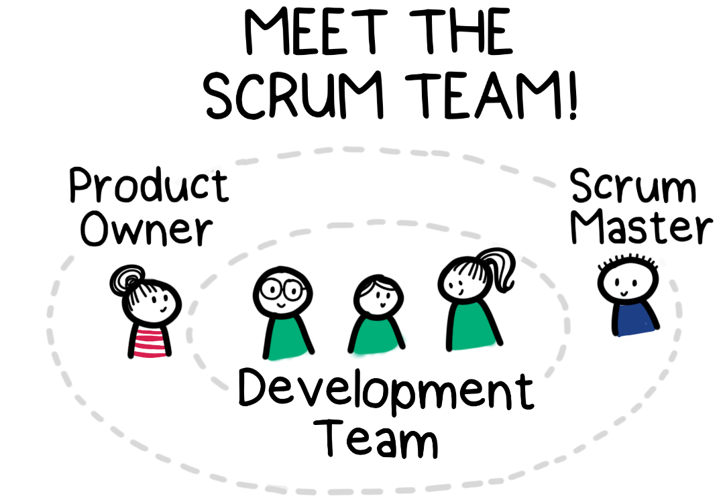
🍾Meet the teams
Data Engineers
Sem | Niels | Nathalie
Geraldine | Ivan | Andrea
Alice | Jens | Gerrit
 | Karel | Miguel
Data Analysts
Alfiya | Em | Daryoush | Viktor
Ariana | Caroline | Bear | Afaf
Yanina | Danil | Nasrin | Mahsa
Fabienne

Slide 3
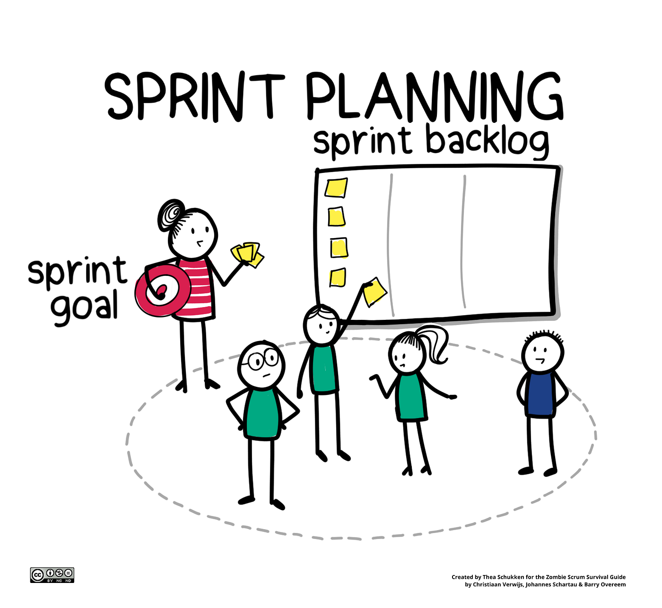
Day 1: Sprint Planning (2 hours max.)
Sprint planning is an event in scrum that defines what can be delivered in the upcoming sprint and how that work will be achieved.
Scrum master takes the lead!
Each team should use a planning tool (e.g. Trello to tackles tasks/story points)
They will lead the daily stand-up for their teams
And report progress during debrief
Are the main point of contact between team and Product Owner

Slide 4
Day 1: Planning Poker (adapted)
For this first time, we will use the story points of the README you may want to add some extras in your team. Each team has a printout they can use to track the story points assigned.

Slide 5
Day 2 - 4: Daily Scrums
Each scrum master will be in charge of doing the daily scrum meetings after our usual start of the day, they will also report back to the Product Owner on the status of the project during debrief.
For example,
Whole class stand-up: We’ll address questions bottlenecks all together.
Team stand-up: 15 mins to align with the team
Debrief: Scrum masters give a status report back to the Product owner.

Slide 6
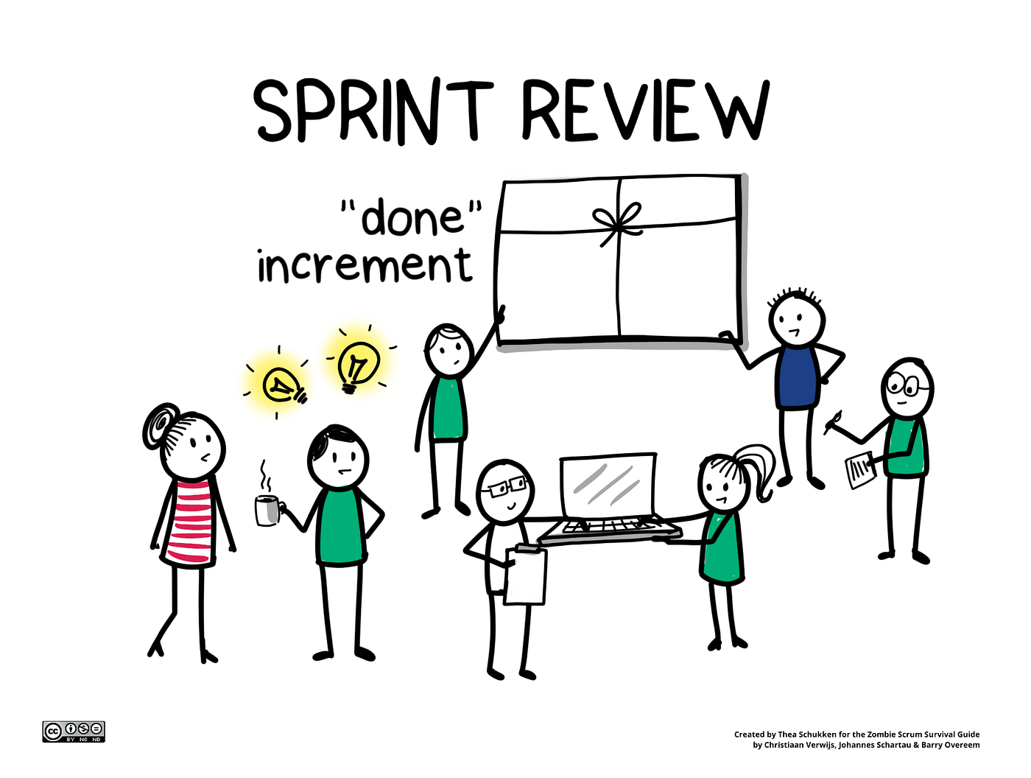
Day 5: Sprint Review (Presentations)
Each team will have 5 minutes to present/ show their demo.
1 question from coach (optional)
All presentations should be done in about 1 hour tops!

Slide 7
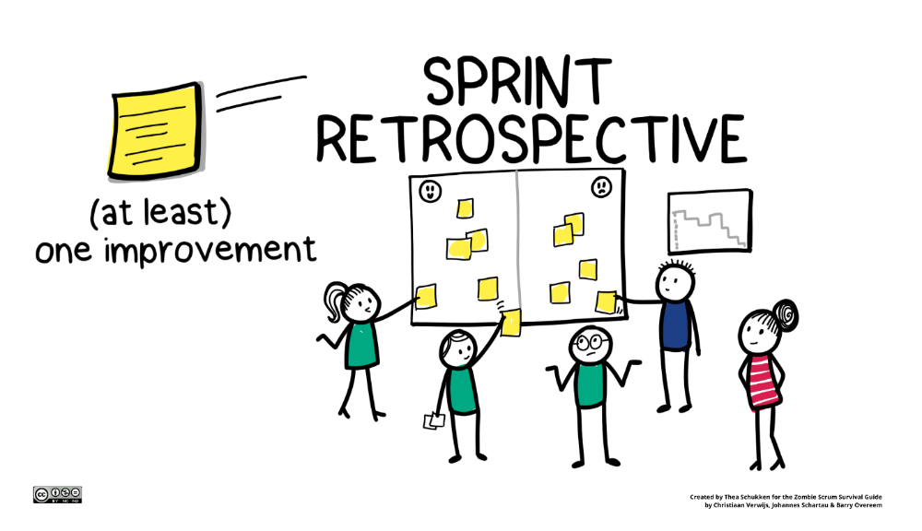
Day 5: Sprint Retrospective (Breakout Rooms)
1-Team-All Retrospective
You will have:
5 minutes to answer each question for yourself
10 minutes to discuss with your team and add your teams answer to this padlet.
15 of group discussion
Then wrap up for next week!

